Slide 1
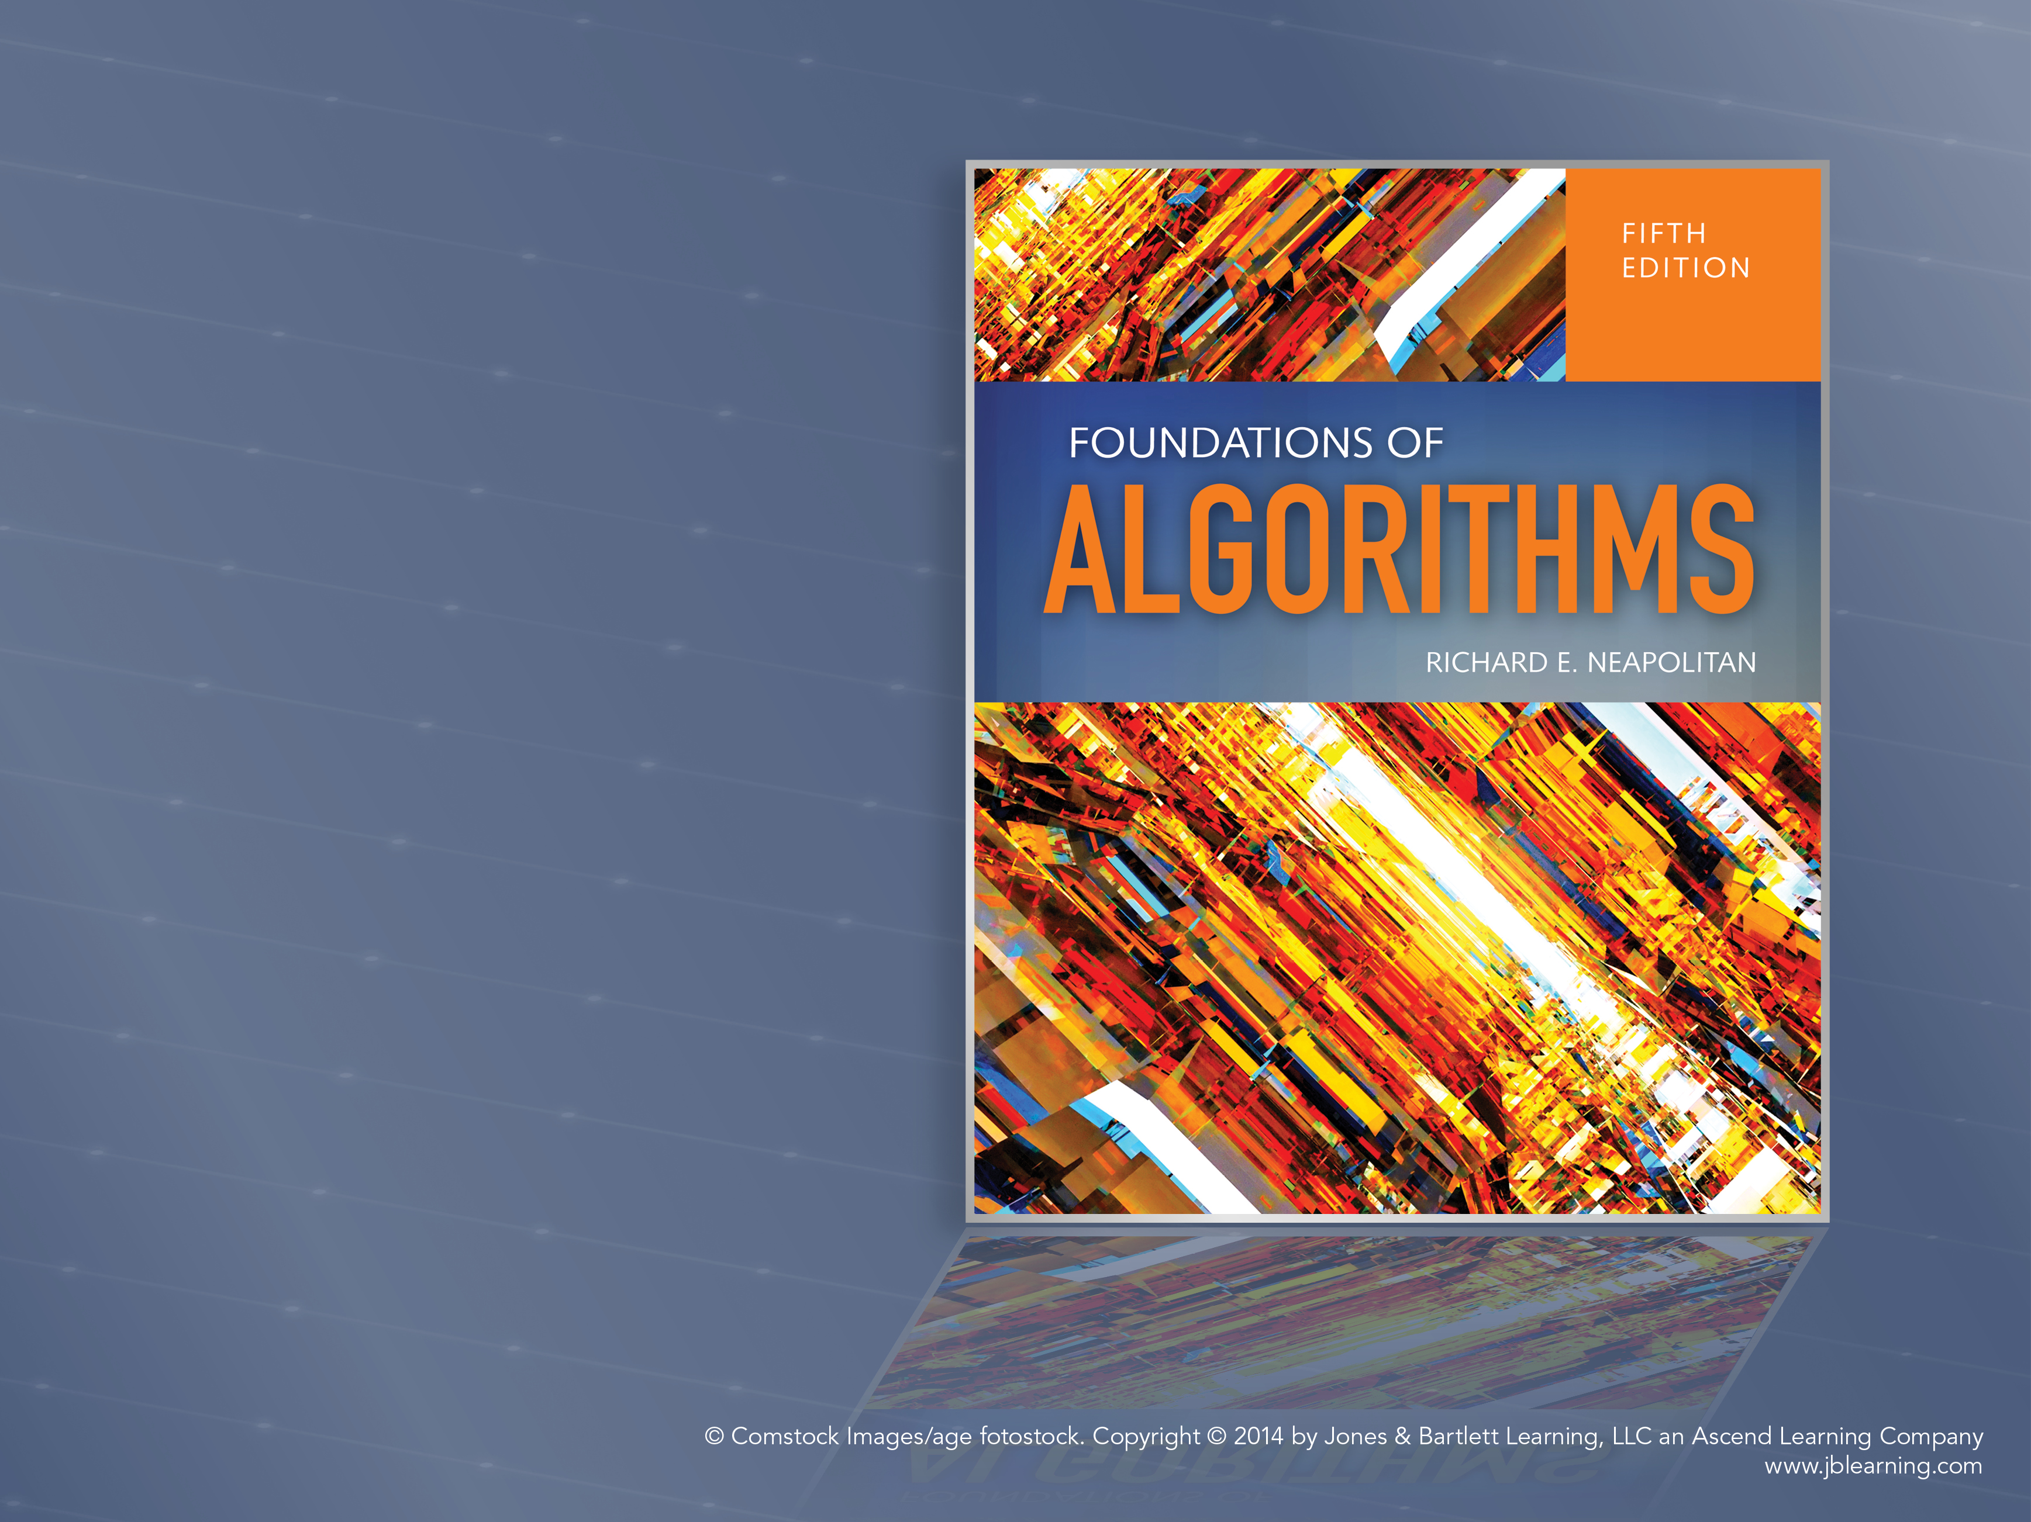
Computational Complexity and Intractability: An Introduction to the Theory of NP
Chapter 9

Slide 2
Objectives
Classify problems as tractable or intractable
Define decision problems
Define the class P
Define nondeterministic algorithms
Define the class NP
Define polynomial transformations
Define the class of NP-Complete

Slide 3
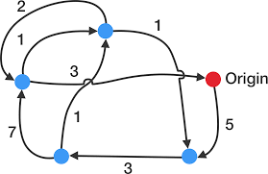

Traveling Salesperson Problem
No algorithm has ever been developed with a Worst-case time complexity better than exponential
It has never been proven that such an algorithm is not possible
NP-Complete

Slide 4
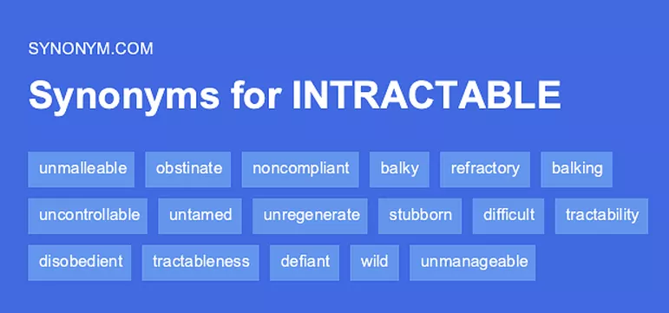
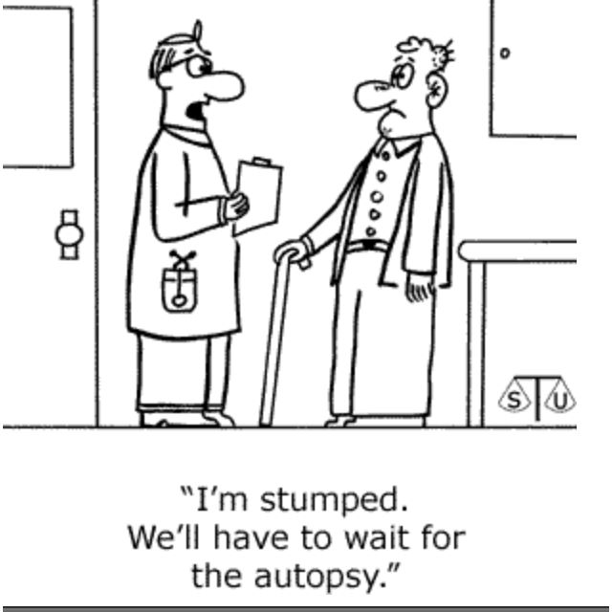
Intractability
Dictionary Definition of intractable: “difficult to treat or work.”
Computer Science: problem is intractable if a computer has difficulty solving it

Slide 5
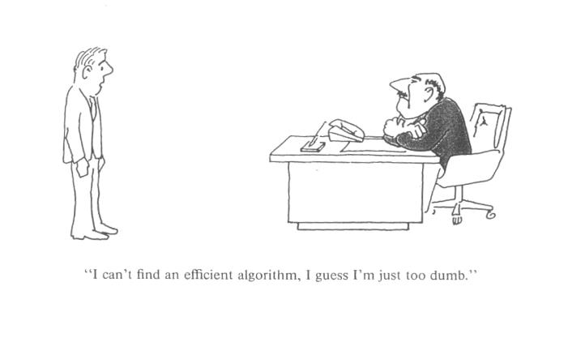
Computational Intractability

Slide 6
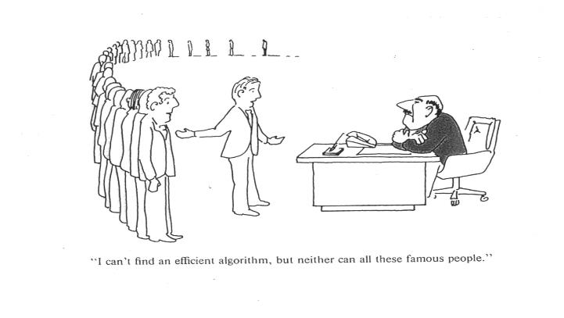
Computational Intractability

Slide 7
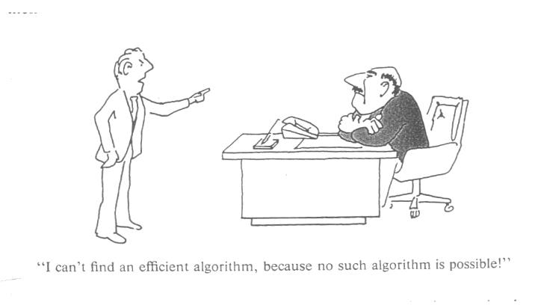
Computational Intractability

Slide 8
Tractable
A problem is tractable if there exists a polynomial-bound algorithm that solves it.
Worst-case growth rate can be bounded by a polynomial
Function of its input size
P(n) = a_{n}n^{k} + . . . + a₁n + a₀ where k is a constant
P(n) ε θ(n^{k})
n lg n not a polynomial
n lg n < n² bound by a polynomial

Slide 9
Intractable
“Difficult to treat or work”
A problem in CS is intractable if a computer has difficulty solving it
A problem is intractable if it is not tractable
Any algorithm with a growth rate not bounded by a polynomial
c^{n}, c^{.01n}, n^{logn}, n!, etc.
Property of the problem not the algorithm

Slide 10
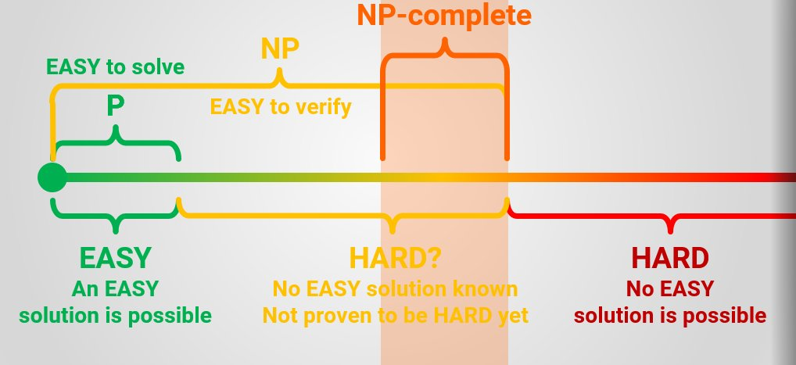
Three General Categories of Problems
Problems for which polynomial-time algorithms have been found
Problems that have been proven to be intractable
Problems that have not been proven to be intractable, but for which polynomial-time algorithms have never been found

Slide 11
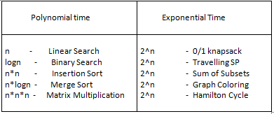
Polynomial-time Algorithms
Θ(nlgn) for sorting
Θ(lgn) for searching
Θ(n³) for chained-matrix multiplication

Slide 12
Proven to be Intractable
Unrealistic definition of the Problem (Hamiltonian Circuits)
Un-Decidable problems: The Halting Problem (proven un-decidable by Alan Turing).
Decidable intractable problems: researchers have shown some problems from automata and mathematical logic intractable

Slide 13
Not proven to be intractable no existing polynomial time algorithm
Traveling salesperson
0-1 Knapsack
Graph coloring
Sum of subsets

Slide 14
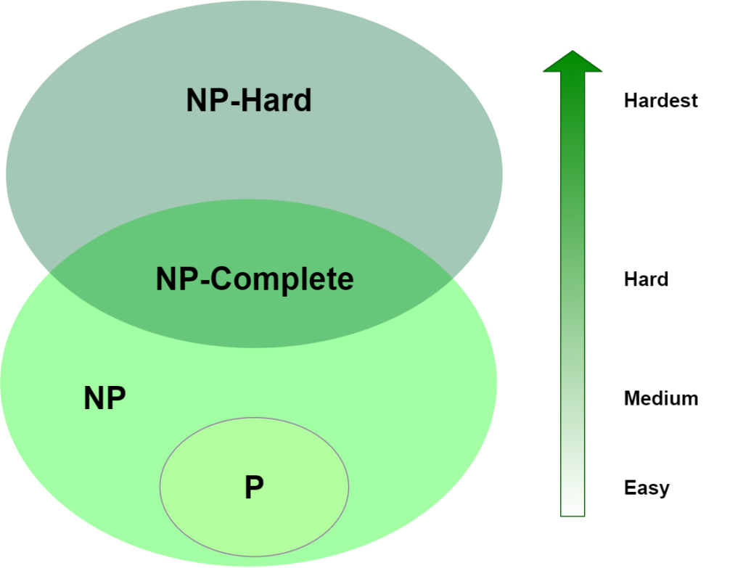
Define
Decision problems
The class P
Nondeterministic algorithms
The class NP
Polynomial transformations
The class of NP-Complete

Slide 15
Decision problem
Problem where the output is a simple “yes” or “no”
Theory of NP-completeness is developed by restricting problems to decision problems
Optimization problems can be transformed into decision problems
Optimization problems are at least as hard as the associated decision problem
If polynomial-time algorithm for the optimization problem is found, we would have a polynomial-time algorithm for the corresponding decision problem

Slide 16
Decision Problems
Traveling Salesperson
For a given positive number d, is there a tour having length <= d?
0-1 Knapsack
For a given profit P, is it possible to load the knapsack such that total weight <= W?

Slide 17
Class P
The set of all decision problems that can be solved by polynomial-time algorithms
Decision versions of searching, shortest path, spanning tree, etc. belong to P
Do problems such as traveling salesperson and 0-1 Knapsack (no polynomial-time algorithm has been found), etc., belong to P?
No one knows
To know a decision problem is not in P, it must be proven it is not possible to develop a polynomial-time algorithm to solve it

Slide 18
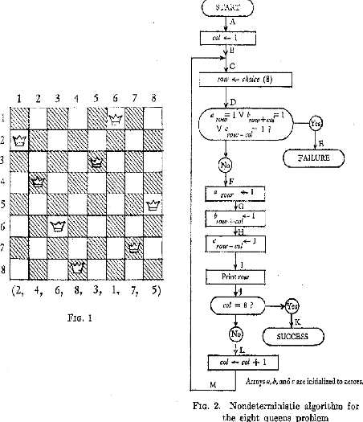
Nondeterministic Algorithms – consist of 2 phases
1. Nondeterministic phase – Guessing Phase: given an instance of a problem, a solution is guessed
2. Deterministic phase – Verification Phase

Slide 19
Deterministic Phase – Verification Phase
Input
Instance of the problem
String s: the guess
Phase proceeds in an ordinary, deterministic manner:
Eventually halts with an answer yes – the guess, s, is a solution to the problem
Eventually halts with an answer no – the guess, s, is not a solution to the problem
Continues executing for ever

Slide 20
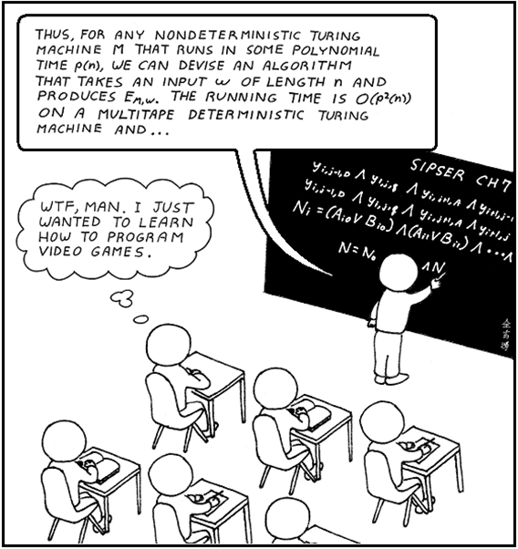
Polynomial-time Nondeterministic Algorithm (NDA)
A nondeterministic algorithm whose verification stage is a polynomial-time algorithm

Slide 21
Class NP
The set of all decision problems that can be solved by polynomial-time nondeterministic algorithms
Nondeterministic polynomial
For a problem to be in NP, there must be an algorithm that does the verification in polynomial time
Traveling salesperson decision problem belongs to NP
Show a guess, s, length polynomial bounded
Yes answer verified in a polynomial number of steps

Slide 22
Suppose answer yes for a given instance of traveling sales person
You may guess all (n-1)! tours before guessing the tour with the yes answer
Polynomial-time verifiability, not solvability
The guess for that tour is done in polynomial time
The verification of the guess is done in polynomial time
Branch and bound probably produces a better solution
Purpose: problem classification

Slide 23
Is P ⊆ NP?
It has not been proven that there is a problem in NP that is not in P
NP-P may be empty
P=NP? One of the most important questions in CS
To show P!=NP, find a problem in NP that is not in P
To show P = NP, find polynomial-time algorithm for each problem in NP

Slide 24
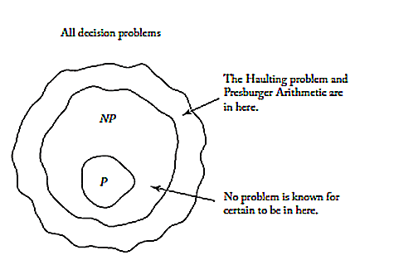
Figure 9.3

Slide 25
CNF
CNF – Conjunctive Normal Form
Logical (Boolean) variable: can have one of two values: TRUE or FALSE
Literal: logical variable or the negation of a logical variable
x is a logical variable
¬x is the negation of a logical variable

Slide 26
CNF
A clause is a disjunction of literals (e.g. p ∨ q ∨ s)
A logical expression is in Conjunctive Normal Form if it is a conjunction of clauses
(p ∨ q ∨ s)∧(¬ q ∨r) (¬ p∨ r) ∧ (¬ r ∨ s) ∧ (¬ p∨ ¬s∨ ¬q)

Slide 27
CNF - Satisfiability Decision Problem
Is there a truth assignment for the variables of a CNF expression which evaluates to true?
For the answer to be yes, each clause must evaluate to TRUE
Assume n variables, 2^{n} rows in the truth table
Easy to write a polynomial-time algorithm takes as input a logical CNF expression and a set of truth assignments to the variables and verifies whether it evaluates to TRUE

Slide 28
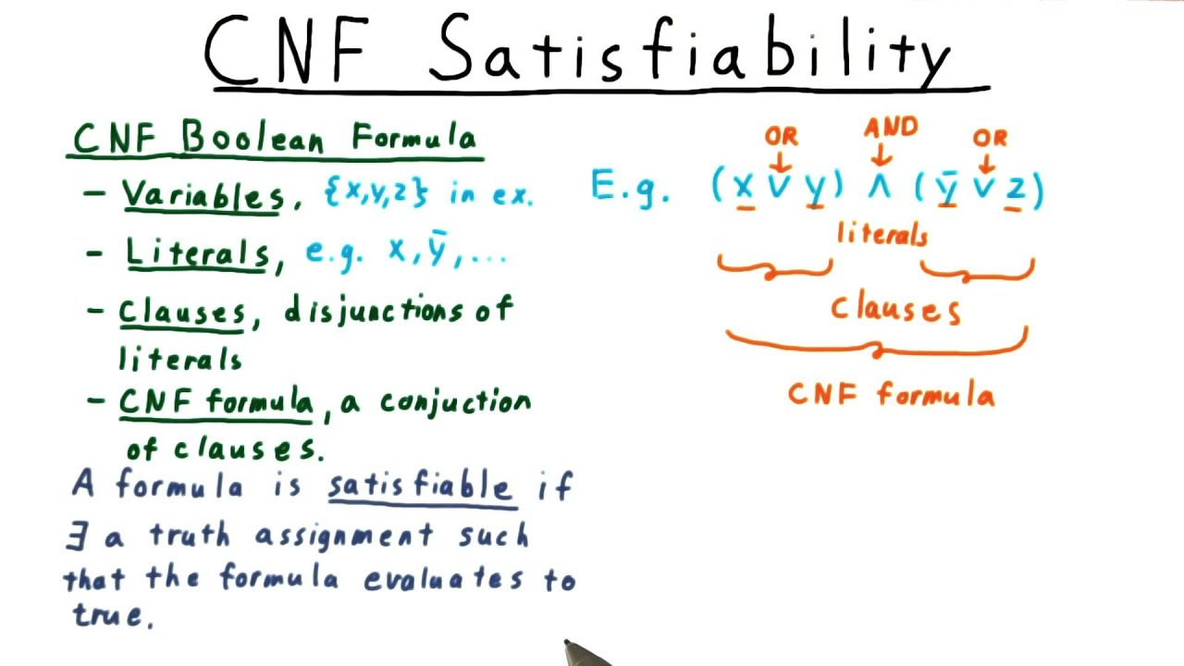
CNF Satisfiability Decision Problem
Problem is in NP
No polynomial-time algorithm for it has been found
Cook proved that if CNF-Satisfiability is in P, P = NP

Slide 29
Polynomial-time Reducibility
Want to solve decision problem A
Have an algorithm to solve decision problem B
Can write an algorithm that creates instance y of problem B from every instance x of problem A such that:
Algorithm for B answers yes for y if the answer to problem A is yes for x

Slide 30
Polynomial-time Reducibility
Transformation algorithm
Function that maps every instance of problem A to an instance of problem B
y = trans(x)
Transformation algorithm + algorithm for problem B yields an algorithm for problem A

Slide 31
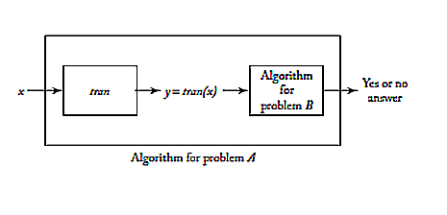
Figure 9.4

Slide 32
Polynomial-time many-one reducible
If there exists a polynomial-time transformation algorithm from decision problem A to decision problem B, problem A is polynomial-time many-one reducible to problem B
A ∝ B
Many-one: transformation algorithm is a function that may map many instances of problem A to one instance of problem B
If the transformation algorithm is polynomial-time and the algorithm for problem B is polynomial, The algorithm for A must be polynomial

Slide 33
Theorem 9.1
If decision problem B is in P and A ∝ B, then decision problem A is in P

Slide 34
Proof
Let p be the polynomial bound on the computation of the transformation algorithm T
Let q be the polynomial bound on the algorithm M for B
The size of T(x) is at most p(n) for input x of size n
Algorithm M with input T(x) does at most q(p(n)) steps
The total work to transform x to T(x) and then apply M to get the correct answer:
p(n) + q(p(n)), which is polynomial in n

Slide 35
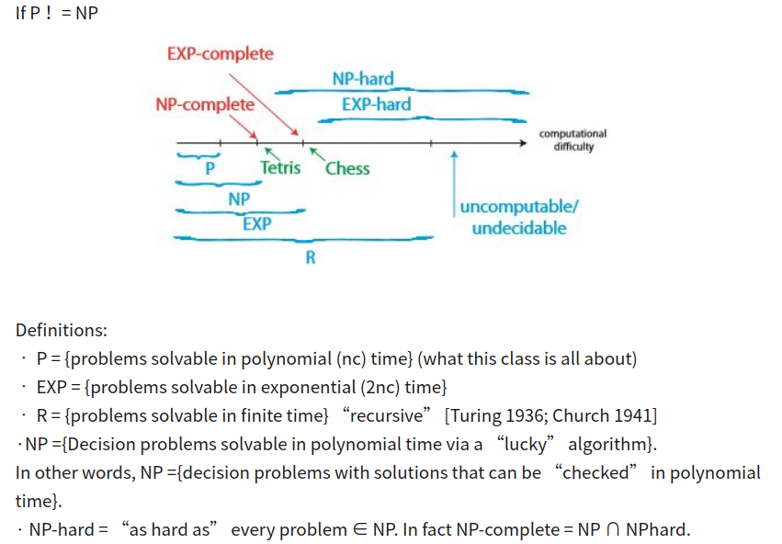
NP-Complete
A problem B is called NP-complete if both the following are true:
B is in NP
For every other problem A in NP, A ∝ B

Slide 36
Theorem 9.2 – Cook’s Theorem
CNF-Satisfiability is NP-complete.
Proof found in Cook (1971) and in Gary and Johnson (1979)

Slide 37
Theorem 9.3
A problem C is NP-complete if both of the following are true:
C is in NP
For some other NP-complete problem B, B ∝ C
Proof is based on the transitivity of reducibility …

Slide 38
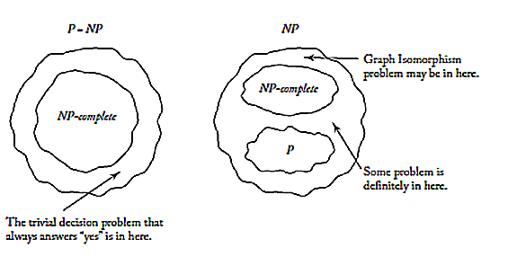
Figure 9.7

